Slide 1
CELL IMAGING 2026
John Ahn, Demetrius Schank, Jonathan Kim

Slide 2
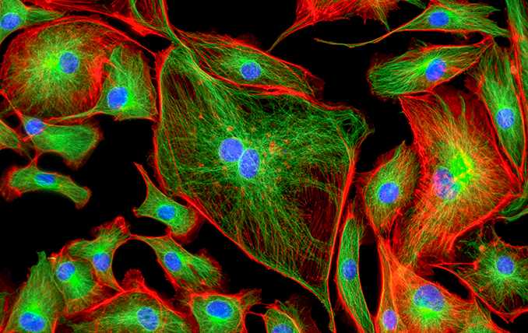
Background
What is cell imaging?
Visualization, observation and study of cells
Importance?
Reveals function
Enables early detection
Can be used for drug discovery and development
Notes:
A quick background into what cell imaging is. Cell imaging, is like the name implies, is a technique to visualize and study cells using microscopes and other imaging tools, such as fluorescent lighting.
Why is it important? It can reveal function of cells at a molecular level that helps scientists understand normal and disease processes, it enables early detection and diagnosis of diseases by identifying abnormal structures and behaviors, and it also allows researchers to discover and develop drugs with real time cell responses.
Also! This is a continuation, or rather an addition, to the current cell imaging team where they determined the velocity of cells in capillaries.

Slide 3
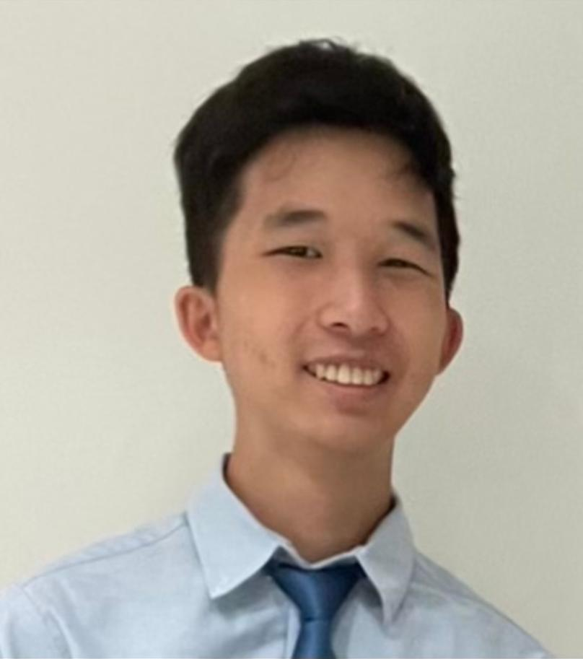
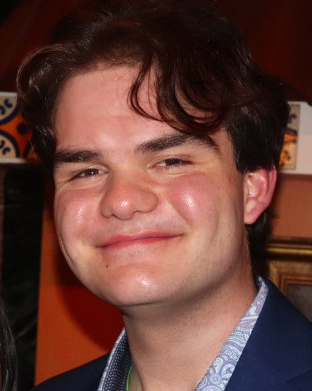

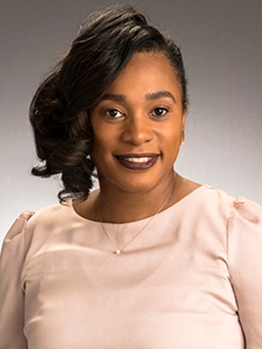
Introduction
Meet our team and advisor!
John Ahn
Prototype Lead & Timeline Manager
Demetrius Schank
Research Lead
Jonathan Kim
MATLAB Lead
Dr. Rosalind Wynne
Team Advisor

Slide 4
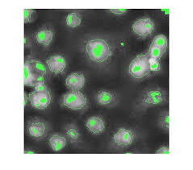
POV Statement
Dr. Wynne needs a low-cost solution for cell imaging because current methods are either too costly or too time consuming.
Notes:
Current cell imaging methods are either costly or require time-consuming manual segmentation, creating a need for an efficient, low-cost solution to accurately detect and count cells.

Slide 5
overview
Current cell imaging methods are expensive.
Manual cell segmentation is accurate but slow and inefficient.
The project aims to develop a cost-effective, accurate method for cell detection.
Existing edge detection tools will be adapted to meet project goals.
Notes:
Current methods for cell imaging require expensive technology.
Furthermore, the most accurate way to define cell boundaries, without the expensive technology, is to do it manually, segmenting the cells by hand and counting them.
As one can assume , this is very timely and inefficient.
Thus, this project was tasked with finding an image analysis method to detect cell boundaries and count cells with accuracy and precision.
Later in project development, we were informed to do so primarily using MATLAB. Existing technologies (both MATLAB and non-MATLAB) exist for edge detection, but the goal of this project is to develop these technologies to accomplished what is described above in a costly manner.

Slide 6
Takeaways
User(s): Dr. Wynne Jiahaw “Jay” Fu
Other Researchers
Need: Cheap and Efficient Cell Image Processing
Insight:
Reliable cell imaging processing technology is not easily accessible for small-budget researchers.
Notes:
The main takeaways we had from our meetings with Dr wynne and the interviews is a need for a reliable and easily accesilbe technology for cell imaging processing

Slide 7

Brainstorming

Slide 8

Interviews
Cell Imaging 2025 Team
Graduate Student
Jiahaw “Jay” Fu
Dr. I
Notes:
We did a total of four interviews, but the two we found the most helpful were the team that did this project before as well as a grad student who is doing research in cell imaging.
The previous team measured the velocity of cells through capilaries, which tells a lot about health and activity. They told us it's not too important what we decided on developing, but it is important for it to be afforadable and accurate.
Their final product was all on matlab, so we decided implement matlab into our design.

Slide 9
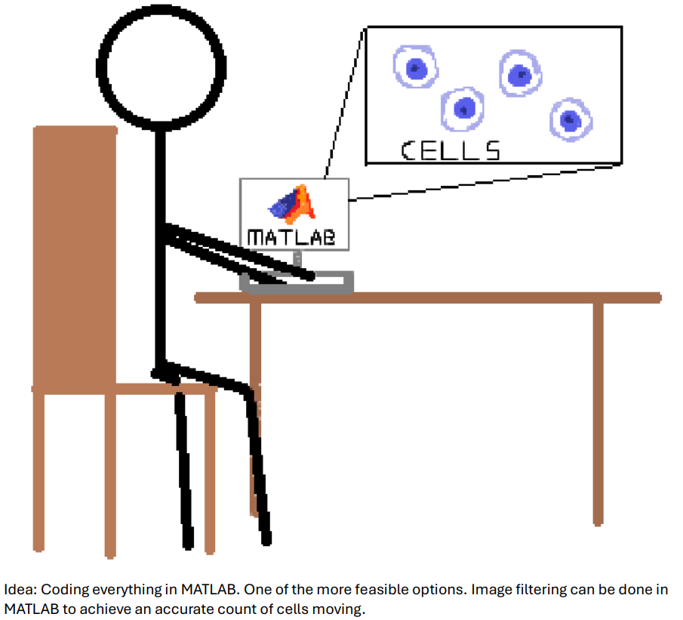
Notes:
Our first idea was to do the entirety of this project on matlab due to image filter options
The team before us also did the their whole project on matlab, so we saw it as the best software option

Slide 10
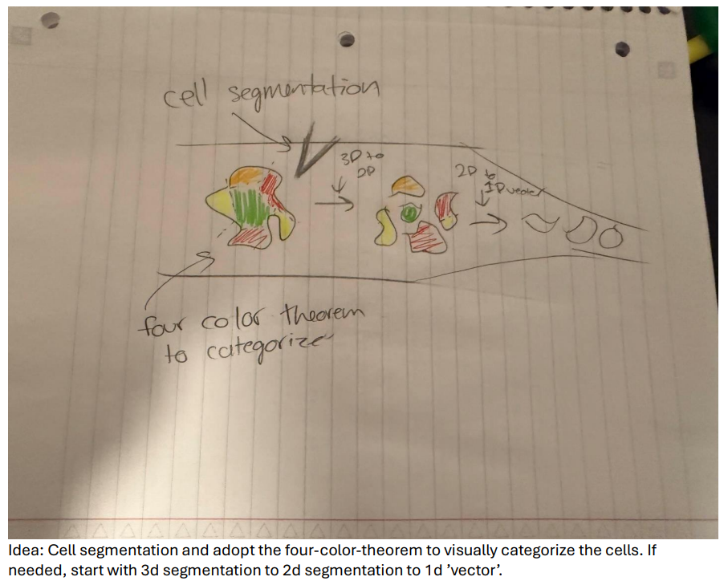

Slide 11
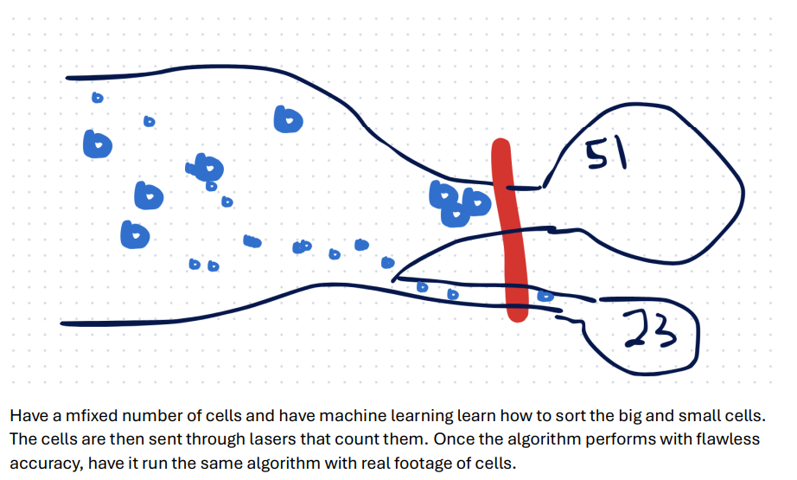

Slide 12
Constraints and criteria
Criteria:
Software
Use existing dataset
Not a physical device
Must detect cell boundaries
Notes:
Criteria:
Must be implemented using MATLAB or other software languages
Must use an already existing dataset (ie. We are not imaging cells ourselves)
Must not make a physical device
Must detect cell boundaries

Slide 13

Constraints and criteria
Constraints:
User friendly: graduate students and researchers
Affordable
Use one type of microscopy
Accurate
Notes:
Constraints:
Be user friendly to graduate students and researchers
Be affordable to graduates and researchers
Use one type of microscopy for consistency
Currently looking into whether a cell is a sickle cell or healthy cell
Detect cell shapes as accurately as possible

Slide 14
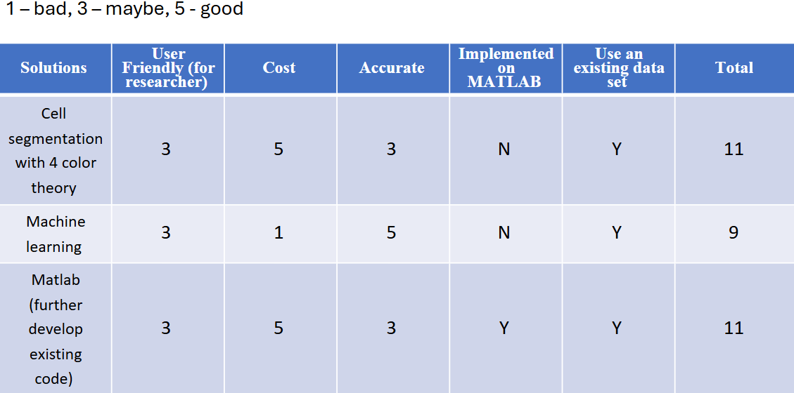
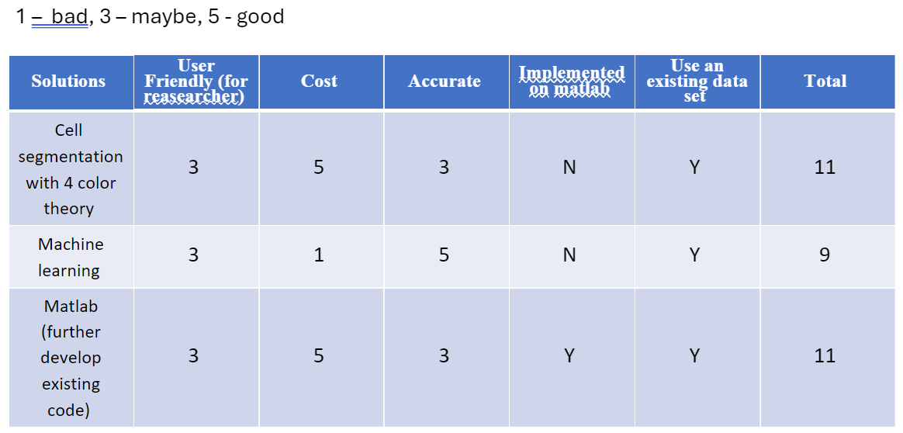
Decision matrix
Notes:
Here is our decision matrix
We decided to mainly stick with matlab
After we submitted this assignment, we learned about the method of highlight and overlaying

Slide 15
Research Conclusions
‘Research’ Conclusions drawing from Literature Review, Interviews, Observations, and Constraints/Criteria.
Limited data availability is a core issue
MATLAB is the primary tool
User-friendliness for researchers was a recurring concern
Affordability vs. Commercial techniques
Image quality and consistency challenges
Interest in machine learning with dataset limitations
Project goals evolved based on data types (Images vs. Videos)
ISO statistical principles emphasized in literature
Segmentation and shape detection as central focus
Notes:
Limited Data Availability Is a Core Issue All sources (especially interviews) emphasized that accessing a robust dataset of cell images or videos is a major obstacle, guiding the team toward the constraint of using existing datasets rather than generating their own.
MATLAB Is the Primary Tool MATLAB was used across all prior efforts due to project constraints. Literature highlights its utility in image segmentation (e.g., CellSegm toolbox), and prior students confirmed all implementation stayed within MATLAB.
User-Friendliness for Researchers Was a Recurring Concern Interviewees stressed the importance of making tools accessible to non-expert users in lab settings, supporting the user-friendly constraint.
Affordability vs. Commercial Techniques Observations noted that current imaging technologies are expensive, pushing the group to prioritize cost-effectiveness through software-based solutions rather than physical devices.
Image Quality and Consistency Challenges The observation video showed inconsistencies across staining methods and imaging platforms, reinforcing the need for accurate detection and robust shape/cell recognition.
Interest in Machine Learning With Dataset Limitations Both literature and interviewees expressed enthusiasm for machine learning, but noted constraints due to small datasets—supporting a direction of statistical methods and simpler algorithms until larger data is available.
Project Goals Evolved Based on Data Types (Images vs. Videos) Prior teams adapted from static images to analyzing velocity in cell videos. This flexibility influenced current teams to define a focused objective early, such as cell boundary detection or shape analysis.
ISO Statistical Principles Emphasized in Literature Literature highlighted techniques consistent with ISO 21247-like standards, validating the project’s goal to incorporate statistical decision-making in binarization or segmentation tasks.
Segmentation and Shape Detection as Central Focus Across literature and interviews, shape and edge detection (via Hough Transforms, ellipse detection, etc.) were central goals, aligning with the accuracy constraint and helping define success metrics.

Slide 16
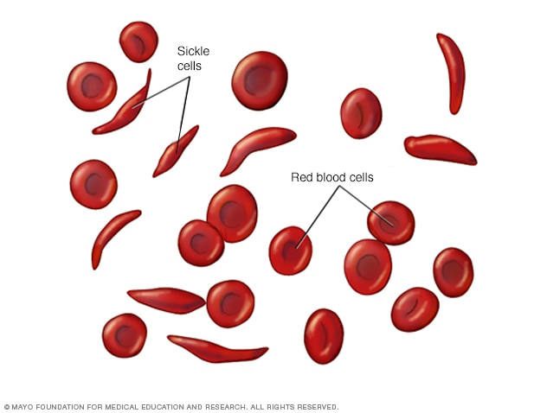
Tasks and thoughts
Task: Identify properties of cells of our choice
Goal: Look at shapes and sizes of cells
Detection of sickle cells
Notes:
In addition to our basic premise, we were tasked by Dr. Wynne to identify properties of our choosing about the cells we analyze.
Our main task at hand is determining what we want to device from cell image analysis besides just cell boundaries and cell count.
Just like how the current cell imaging team determined the velocity of cells, we decided to look into of detecting size and shapes.
Different cell types have distinct shapes and size and can tell a lot health and indicate diseases, and we wanted to look deeper into sickle cells

Slide 17
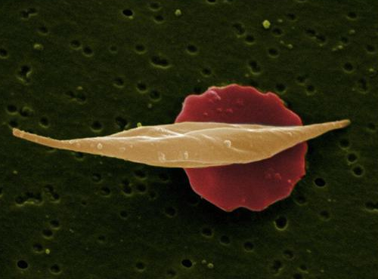
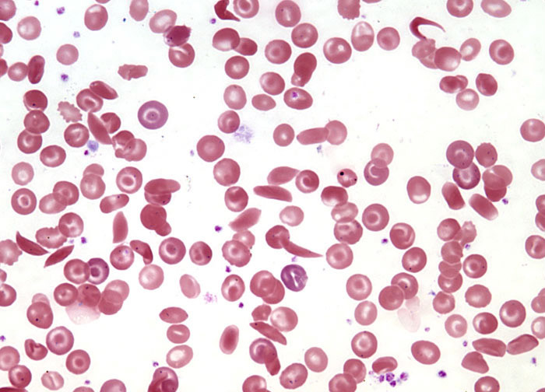
Sickle Cell Disease
Fluorescence Microscopy
Characterized by rigid,
sickle – shaped red blood cells
Leads to blockages in blood vessels and reduces
Light Microscopy
Notes:
Sickle Cell Disease (SCD) is a genetic disorder where red blood cells become rigid and sickle-shaped due to abnormal hemoglobin (HbS), leading to blockages in blood vessels and reduced oxygen delivery.
It is most common in less developed regions of the world, such as Sub-Saharan Africa, parts of middle East and other areas, so making it affordable is important
// Light microscopy helps visualize the sickled cells, while fluorescence microscopy highlights hemoglobin distribution and oxidative stress

Slide 18
Flowchart
Start
Input Image
Preprocessing
(denoising, image enhancing, possible grayscale conversion)
Processing
(Cell/shape threshold detection, cell roundness calculation)
Cell is likely round
Yes
Classify Healthy
No
Classify Diseased
End

Slide 19
Processing Example

Slide 20
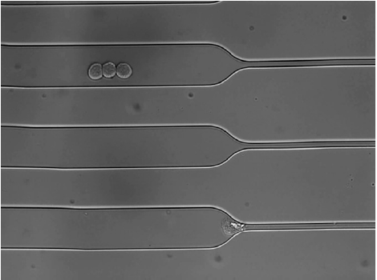
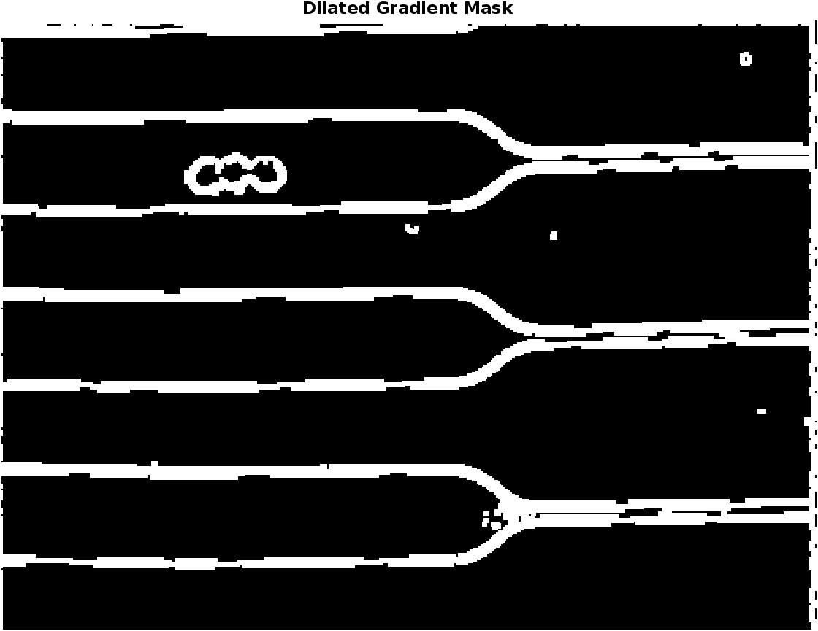
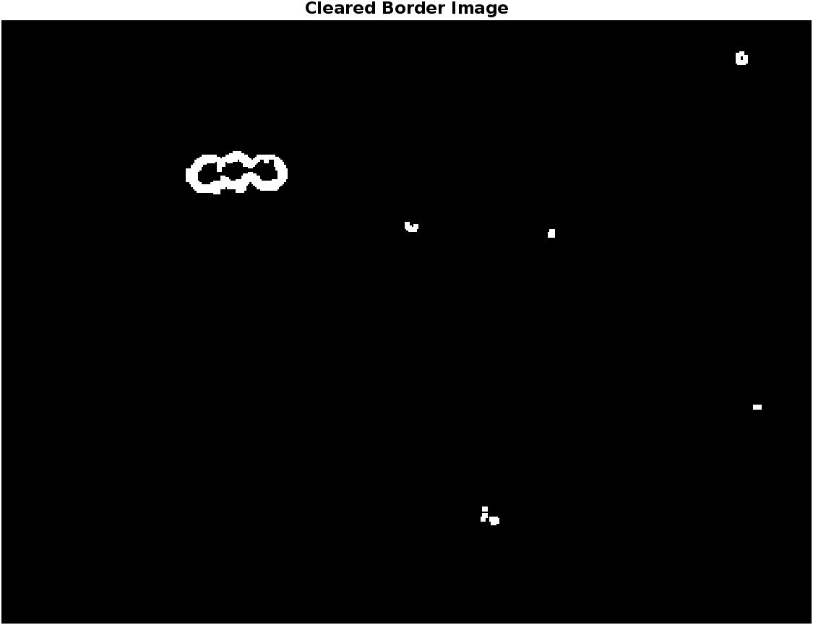
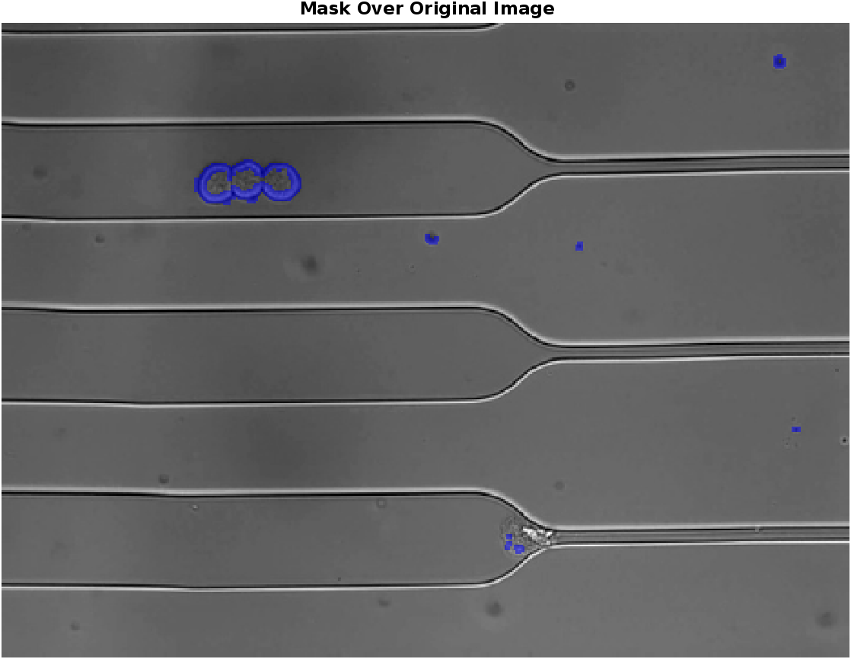
Original Image
Find significant change in contrast in image and fill gaps
Remove objects connected to border
Highlight and overlay

Slide 21
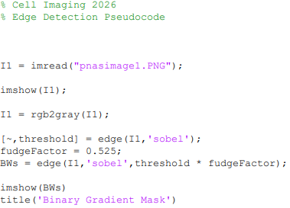
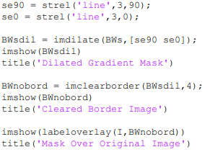
MATLAB CODE

Slide 22

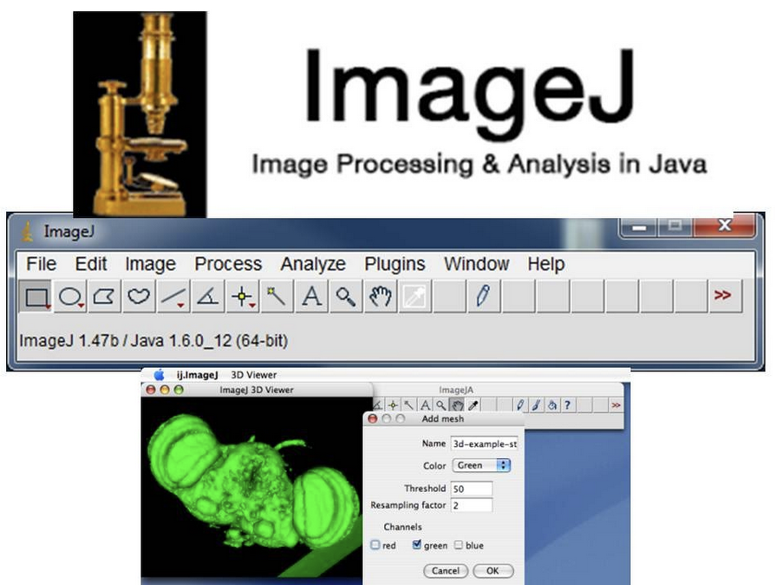
Materials and tools
Tools:
Matlab – add onto existing work
ImageJ – aid with image processing
Notes:
Materials:
Our project is primarily software base. Nothing physical will be built. Our data will be collected from public domain research databases. Because of this, we are not expected to use any physical materials for our design.
Tools:
MATLAB:
MATLAB compatibility is a required criterion for our project as requested by our advisor. It will enable us to add onto existing work performed by the previous capstone design group. Thus, MATLAB is an essential tool our group will need. As Villanova Engineers, we have access to MATLAB included in our tuition.
ImageJ:
ImageJ is an existing image processing software, and is often used for cell image processing. Having ImageJ will enable our group to compare our design to an already existing design, hopefully improving upon ImageJ’s performance. It is a program written in Java, written by NIH and is thus in the public domain (free to use).

Slide 23
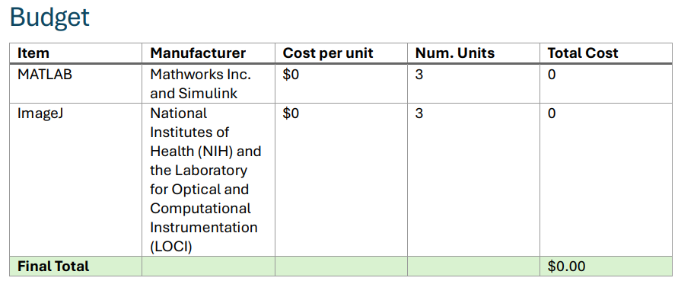
Cost

Slide 24
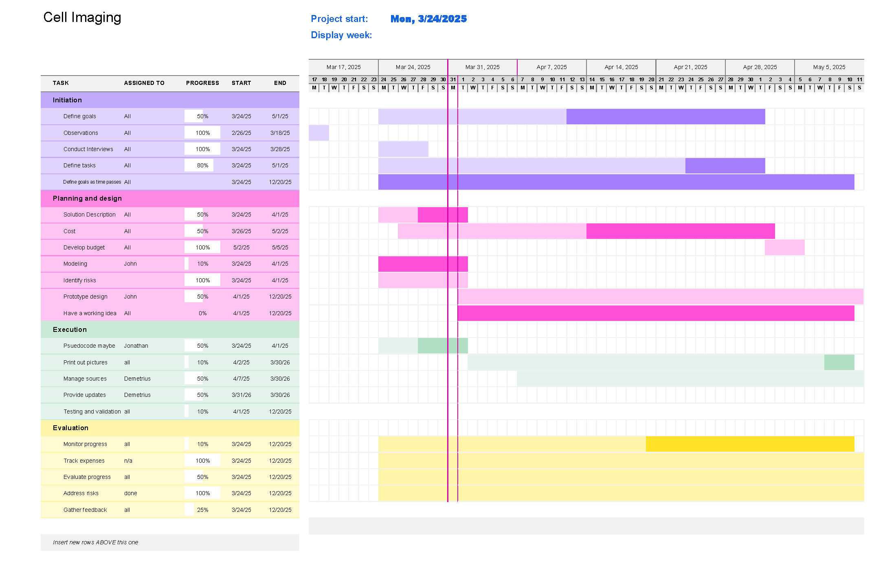
Gantt chart

Slide 25
Timeline
Research
Coding Implementation
Testing and reiteration
Release product

Slide 26
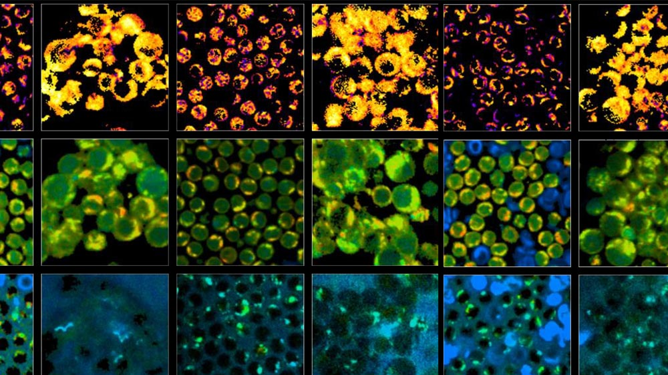
Summary
Cell imaging is either expensive or time inefficient.
Need to detect cells, edge of cells, and properties of cells (sickle shape) using MATLAB.
Shapes and size are properties worth looking into for cell detection
Limited data set may act as obstacle to machine learning

Slide 27
Thank you

